Slide 1
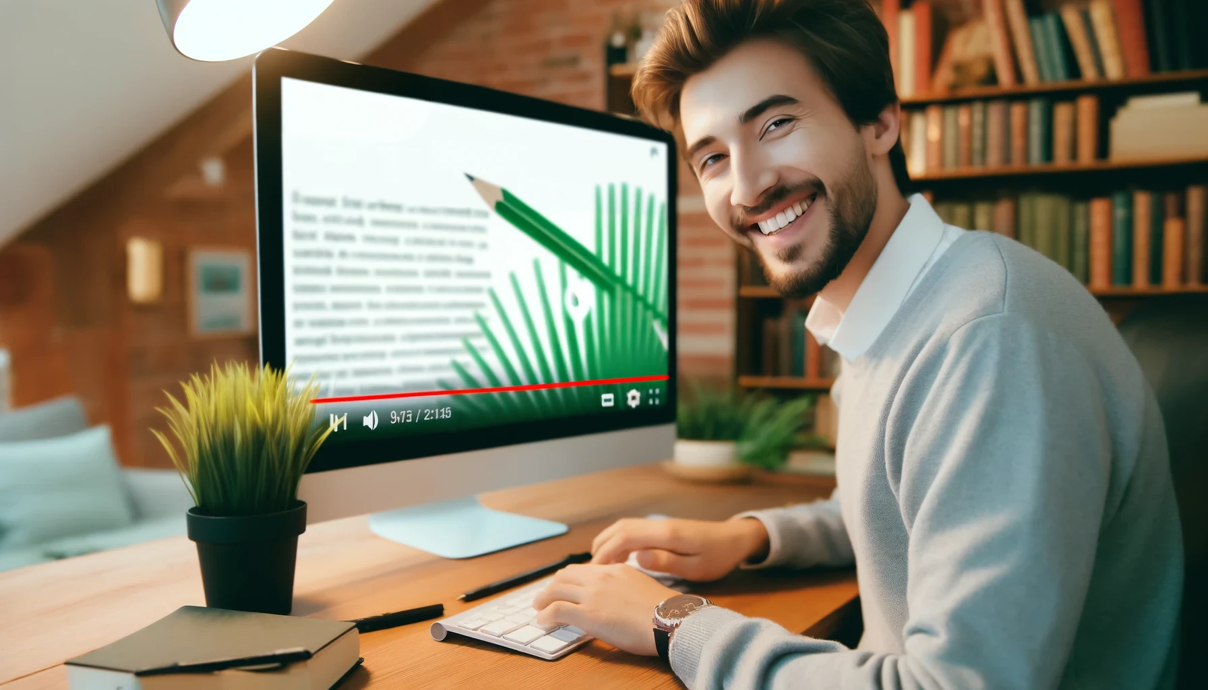
How to Really Use
Grammarly

Slide 2
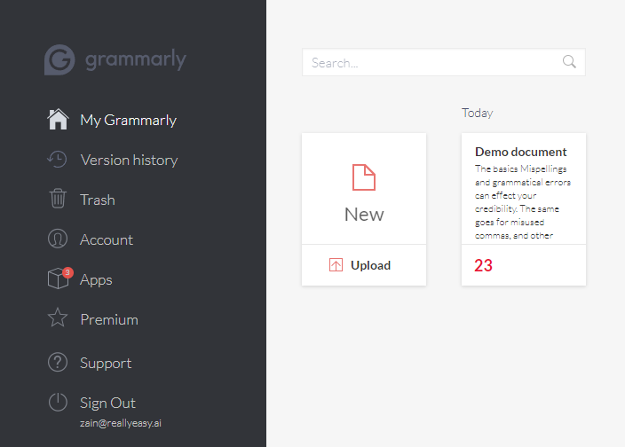
What is the My Grammarly web app?
Notes:
https://app.grammarly.com/

Slide 3
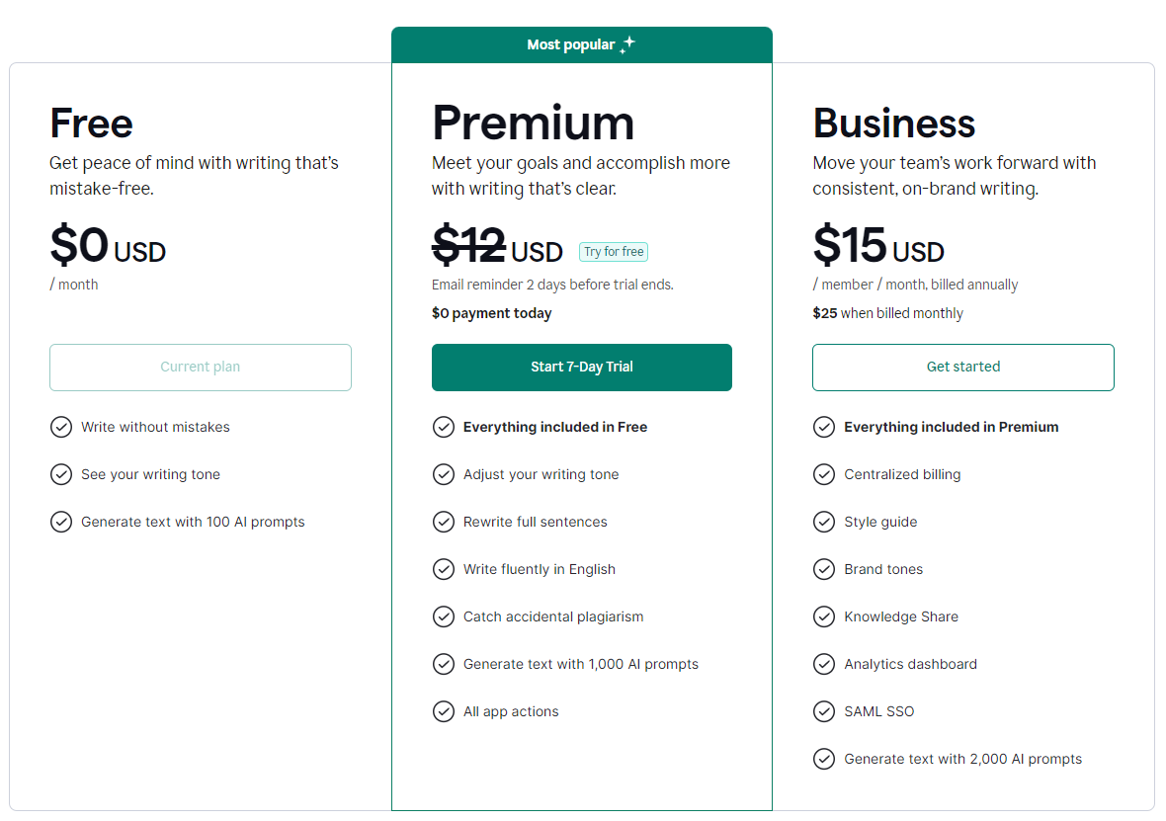
Upgrading to premium
Notes:
https://www.grammarly.com/plans

Slide 4




Notes:
https://www.youtube.com/channel/UC35ZpwldGw7ZJ5R-2sLijzw

Slide 5

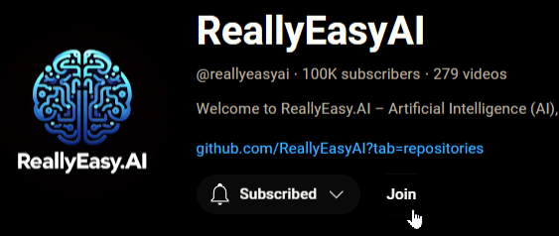
Membership has its privileges
Notes:
https://www.youtube.com/channel/UC35ZpwldGw7ZJ5R-2sLijzw/join

Slide 6
Revisiting the My Grammarly Web app
Notes:
https://app.grammarly.com/

Slide 7
